Slide 1
NAWIC SCR PR/Marketing & Membership 2017-2018
October 21, 2017

Slide 2
I'm a chapter chair… NOW WHAT?
Talk to your president – Ask what worked and what didn’t? Ask what they need from you!
Ask for a list of contacts from the previous year along with each members contact info.
Ask for any logins and passwords you may need to help with social media or email accounts
Have committee meetings , delegate the work. PR/Marketing and Membership are very big shoes to fill, your co-chair and Committee or board members are there to help!

Slide 3
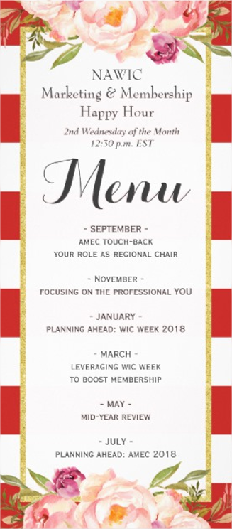
*Attend the Conference calls held by National
Your Duties
Press Releases
Press releases help get information to the community about your chapter.
Meetings and events need to be shared in any local publication that is FREE!
How do I start?
Ask your president what she needs you to do to help grow the chapter.
For membership that might be throw a membership recruiting event and for marking that might be creating a new sponsorship flyer and sending it out. Your president is there to point you in the right direction.
Share The Success
Share what your chapter is doing on Facebook and other social media sites.
Don’t forget scr cares too! Share on our regions page!
Congratulate chapter members for hard work and accomplishments via social media.
Welcome new members!

Slide 5
Online Resources

Slide 6
What Media outlets do you USE??
97% of online adults say they have visited or used a social media network within the last month!
83% of Female internet users are on Facebook
21% of all U.S. adults use twitter
25% of all U.S. adults use LinkedIn
Snapchat reaches 41% of 18-34 year olds in the U.S. everyday
32% use Instagram
Female internet users are more likely to use Instagram then men
From Small Business Trends Magazine

Slide 7
WIC Week
ADD THE LOGO TO YOUR EMAIL
WEAR THE PIN- $1.00
Contact your local NEWS station
Contact your Local Paper
Contract your Governor or mayors office for a proclamation
Hold a membership event
Speak with a college group
Set up at a trade show
DON’T LOOSE Momentum! Get info from potentials so that you can reach back out to them.

Slide 9
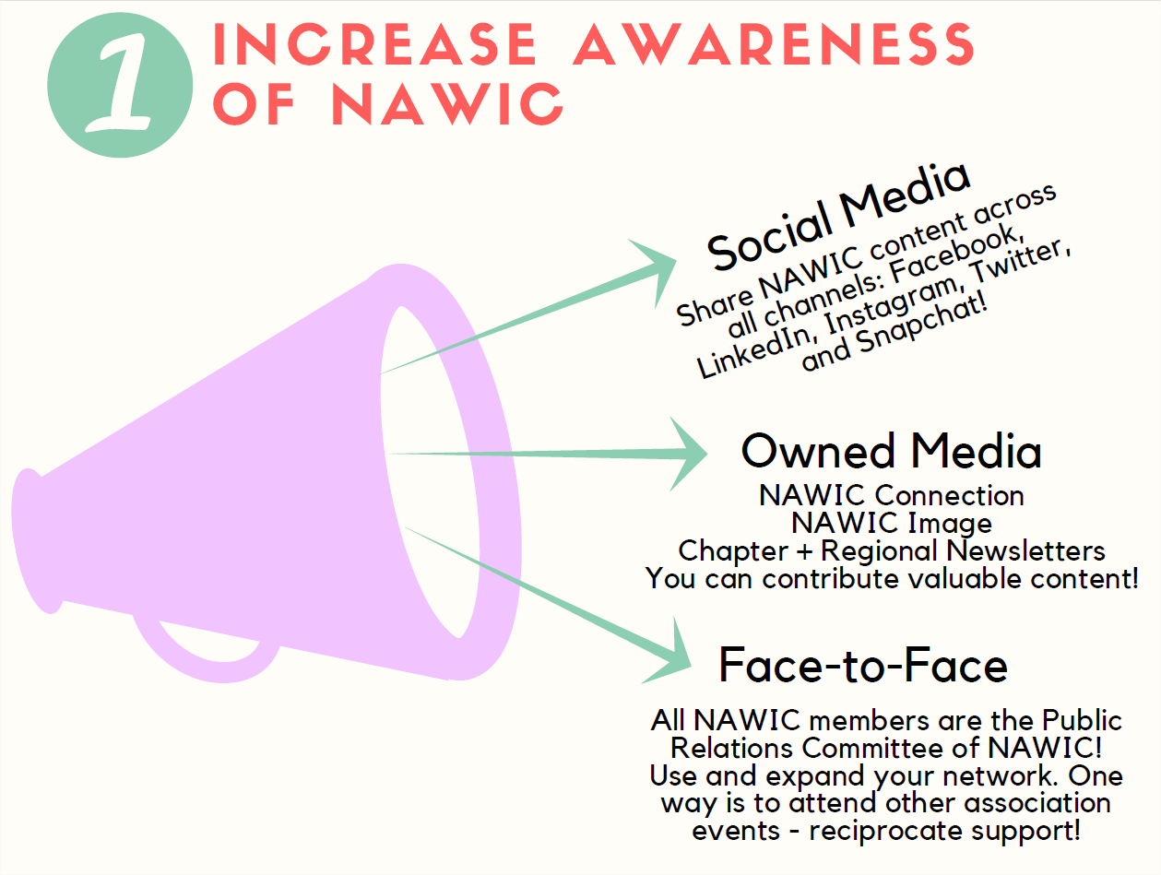

Slide 10
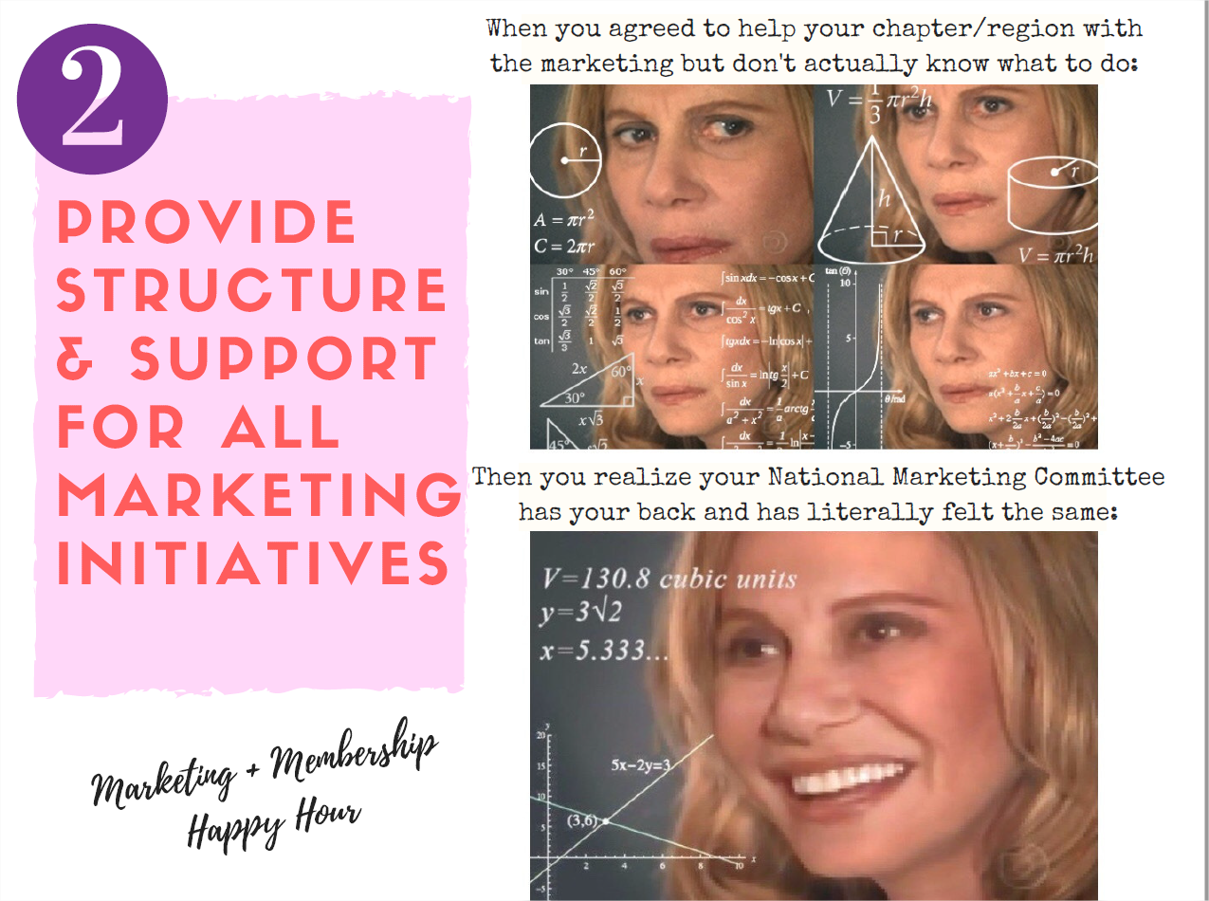

Slide 12
NATIONAL

Slide 13
MEMBERSHIP REGIONAL CONTEST
1. Largest Event Attendance combined with Marketing Committee
2. Retention
Ways to complete these goals
FOLLOW UP!
Make Meetings Interesting and Positive
Communicate by phone and Email

Slide 14
WE NEED YOU!!!
PR/Marketing Chair Opening
Membership Chair Opening

